Slide 1

SyriaTel Customer Churn Analysis
Predicting customer churn to protect revenue and improve retention strategies through data-driven insights.

Slide 2

The Business Challenge
The Problem
The Solution
SyriaTel is losing revenue as customers stop using services. Replacing customers costs more than retaining existing ones.
Build a binary classification model to predict customer churn using usage patterns, service plans, and customer service interactions.
Despite having rich customer data on usage, billing, and demographics, the company lacks predictive tools to identify at-risk customers early.
Enable proactive retention actions on high-risk customers to protect revenue.

Slide 3
Project Objectives
01
02
03
Build Predictive Model
Identify Key Factors
Compare Models
Create accurate binary classification using usage patterns and service data
Determine which variables strongly associate with customer churn
Evaluate multiple approaches to select the most effective method
04
05
Ensure Reliability
Drive Decisions
Measure generalization to unseen data for consistent performance
Support data-driven strategies to reduce loss and improve revenue

Slide 4
Dataset Overview
3,333
21
0
Total Customers
Features
Missing Values
Complete records analyzed
Data points per customer
Clean, complete dataset
Data Categories
Key Variables
16 numerical features (usage, charges, calls)
Usage patterns (day, evening, night, international)
5 categorical features (plans, location)
No duplicates or missing data
Service plans and billing details
Customer service interactions

Slide 5
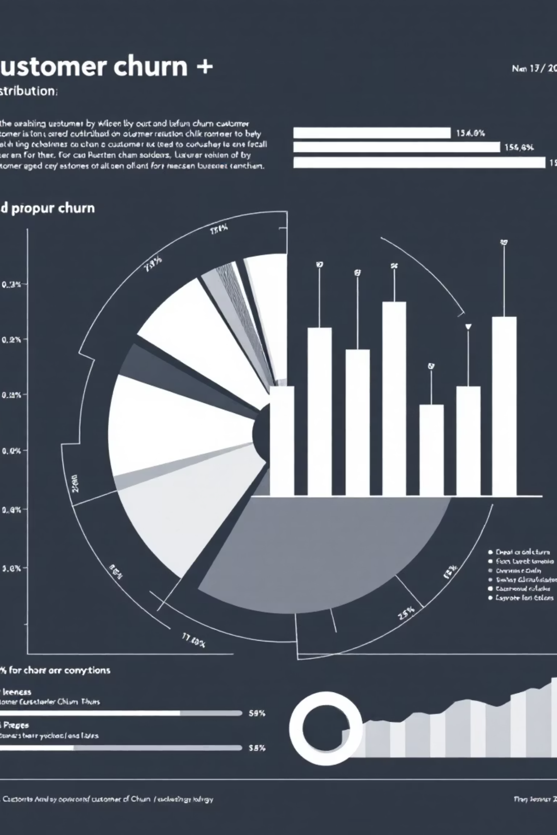
Churn Distribution Insights
Class Imbalance
Dataset shows significant imbalance between churned and retained customers, requiring special handling techniques like SMOTE.
Geographic Patterns
Area code analysis reveals regional variations in customer behavior and churn rates across service territories.

Slide 6
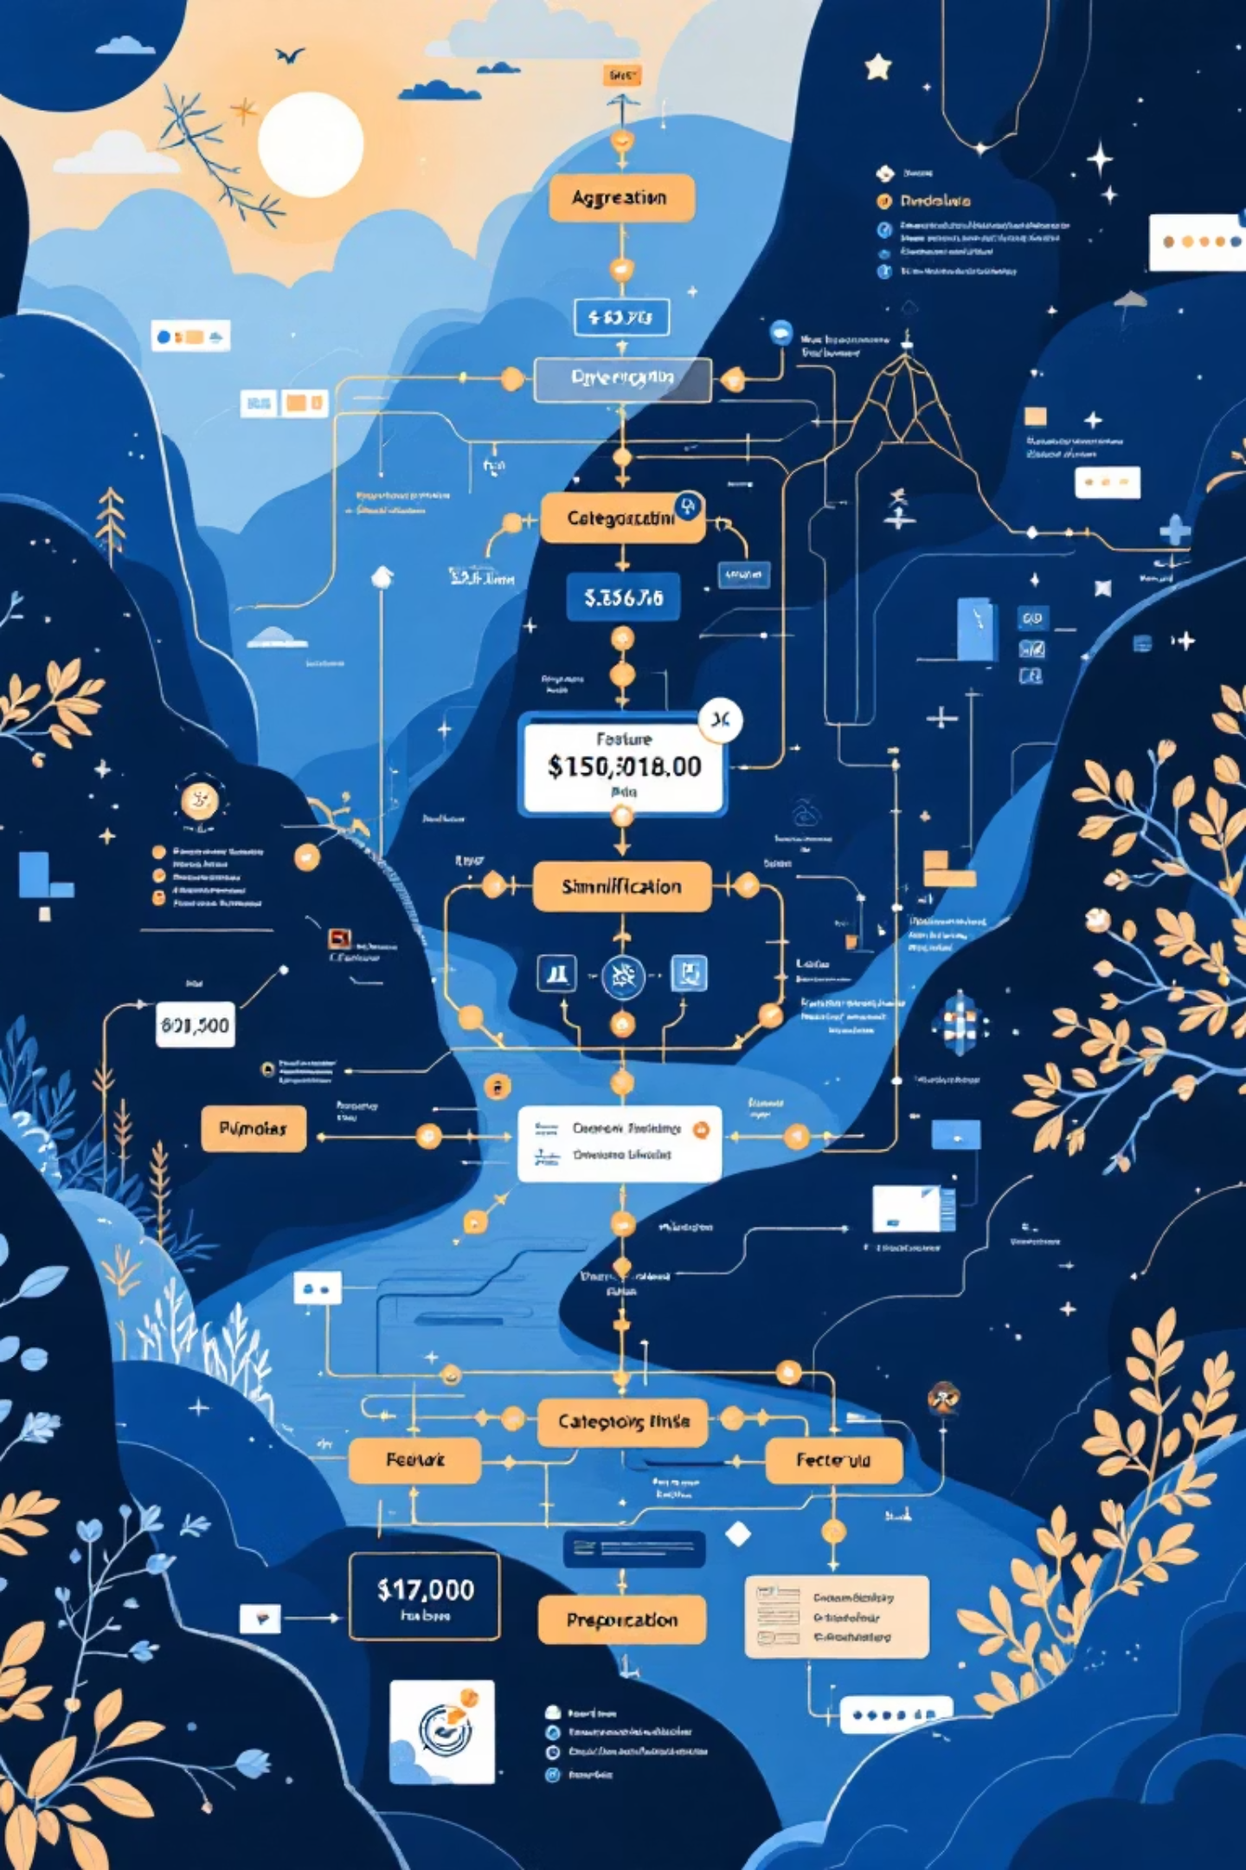



Feature Engineering
Aggregation
Combined day, evening, night, and international metrics into total_minutes, total_charges, and total_calls
Simplification
Dropped redundant columns and non-predictive features like area_code and state
Preprocessing
Applied StandardScaler to numerical features and OneHotEncoder to categorical variables

Slide 7
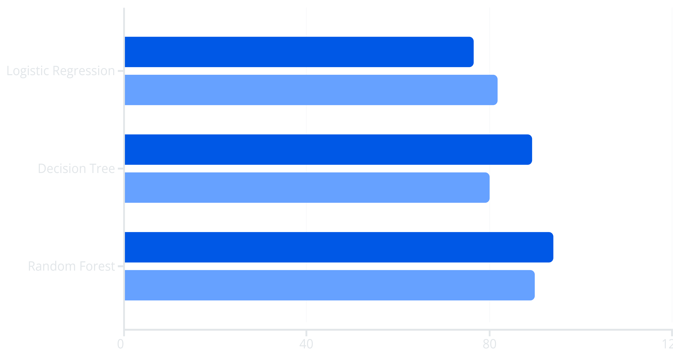
Model Performance Comparison
Accuracy
ROC-AUC
Random Forest emerged as the clear winner, achieving 94% accuracy and 90% ROC-AUC score, significantly outperforming other models in both overall accuracy and ability to discriminate between churners and non-churners.

Slide 8
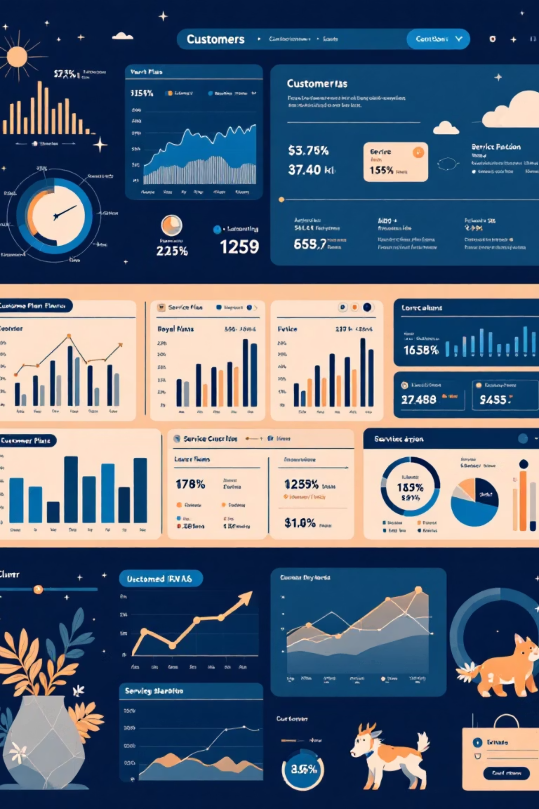
Random Forest: The Winning Model
High Precision
Balanced Performance
98.3% precision on churn class means when the model flags a customer as likely to churn, it's almost always correct.
59.8% recall captures majority of at-risk customers while maintaining excellent precision for targeted interventions.
Strong Discrimination
90% ROC-AUC demonstrates superior ability to distinguish between customers who will churn versus those who will stay.

Slide 9

Key Churn Drivers Identified
Customer Service Calls
International Plans
Usage Charges
High volumes of customer service interactions serve as early warning signals of dissatisfaction and potential churn.
Subscription to international plans represents a distinct risk segment requiring targeted retention strategies.
Elevated usage charges and pricing exposure strongly correlate with increased likelihood of customer attrition.

Slide 10

Strategic Recommendations
Deploy Predictive Model
1
Implement Random Forest model as primary churn prediction tool across CRM systems
Monitor Early Warnings
2
Track customer service calls, international plans, and usage charges as leading indicators
Target High-Risk Customers
3
Focus retention resources on customers with highest predicted churn risk and revenue impact
Continuous Improvement
4
Regularly retrain model with new data to maintain accuracy as customer behavior evolves

